Slide 1

VSB COLLEGE OF ENGINEERING TECHNICAL CAMPUS
[Approved by AICTE and Affiliated to Anna University, Chennai]
[NBA Accredited Courses] [Recognized under 2(f) of UGC Act]
Solavampalayam, Kinathukadavu.
COIMBATORE – 641 022
A BUS NAVIGATOR
GUIDE NAME: Mrs. B. SUBHASHREE, M.E.,
TEAM MEMBERS
BHARATHIPRIYA D [723720104010]
BRINDHADEVI K [723720104011]
DEEPIKA R [723720104012]

Slide 2
AGENDA
INTRODUCTION
PROBLEM DEFINITION
NEED FOR A BUS NAVIGATOR
OBJECTIVES
EXISTING SYSTEM
PROPOSED SYSTEM
IMPLEMENTATION
FUTURE ENCHANCEMENT
REQUIREMENTS
MODULES
REFERENCES

Slide 3
INTRODUCTION
The Bus navigator project is a software application developed to assist people in navigating public transportation systems, particularly buses. Its primary objective is to simplify the process of planning bus routes and finding one's way around new areas or neighborhoods. Typically, the application features a map of the surrounding region and provides users with up-to-date information about bus schedules and routes. By entering their starting point and destination, the software generates the most efficient bus route, including details like bus stops, transfers, and estimated travel time.

Slide 4
PROBLEM DEFINITION
As part of our profession most of us used to travel by bus. At that time we may face difficulty in time keeping. So that we may be too early or too late for the bus. If we are too early 3 we get tired of waiting for long time or if we are late to the bus it may lead to our absence on that particular day and our work or studies will get affected for the one day. To address these challenges, the bus navigator project has been developed as a solution to help commuter’s better plan their bus travel and ensure they arrive at their destination on time.

Slide 5
OBJECTIVES
Develop a user-friendly bus navigation system: The primary objective of the mini project is to create a user-friendly bus navigation system that helps users find the best bus routes and navigate through the city efficiently.
Multi-modal transportation support: Consider incorporating multi-modal transportation options, such as integrating bus routes with other modes of transportation like trains or trams, to provide users with seamless travel options.
Display maps and directions: Present users with visual maps and step-by-step directions for their chosen bus routes. The system should offer clear instructions and landmarks to help users navigate through the city effectively.

Slide 6
NEED FOR A BUS NAVIGATOR
The Bus navigator project, users no longer have to rely on guesswork to determine the most efficient bus route. Instead, they can use the software to access real-time information on bus schedules and routes, including any delays or changes. Furthermore, the bus navigator project can help users avoid the stress of waiting for long periods or missing their bus entirely. By providing accurate estimates of travel time and suggested arrival times, the software can help users plan their trip to arrive at the bus stop just in time for their bus's arrival. Overall, the bus navigator project is a valuable tool that can help make bus travel more convenient and efficient for commuters. By leveraging technology to provide real-time information and personalized guidance, the software can help users save time, reduce stress, and arrive at their destination on time

Slide 7
EXISTING SYSTEM
There are already solutions available that can track the real-time location of vehicles or objects. However, we aim to differentiate ourselves from these existing solutions by not only displaying the distance between us and the bus in kilometers but also by implementing an estimated time display feature that provides an approximate time for the bus to reach us. Additionally, our solution will be user-friendly and accessible via a mobile application that can be easily downloaded and used by anyone.

Slide 8
PROPOSED SYSTEM
The Bus Navigation System we have proposed is designed to simplify the process of tracking and monitoring the location of buses in real-time. This system consists of two Android applications: one for updating the current location of the bus and another for fetching and displaying the location data. By using this system, users can easily determine the current location of the bus and the estimated time of arrival at their destination.
One of the main features of our system is the ability to share the live location of the bus with the users. This feature enables users to track the bus's location in real-time, providing them with accurate information about the bus's current location and movement. The location data is displayed on a user- friendly interface integrated with Google Maps, which makes it easier for users to view the location of the bus.

Slide 9
REQUIREMENTS
SOFTWARE REQUIREMENTS:
FIREBASE
MIT APP INVENTOR
HARDWARE REQUIREMENTS:
:
R A M Capacity :
Mouse :
Keyboard :
Monitor :
Mo ther Board :
Speed :
Processor
Intel Dual Core 4GB
10 GB
Logical Optical Mouse 104 Key
16 inches
Intel
2GH Z

Slide 10
MODULES
Location Adapter App
Location Receiver App
User Interface of Location Adapter App
User Interface of Location Receiver App
FIREBASE Database

Slide 11
IMPLEMENTATION

Slide 12
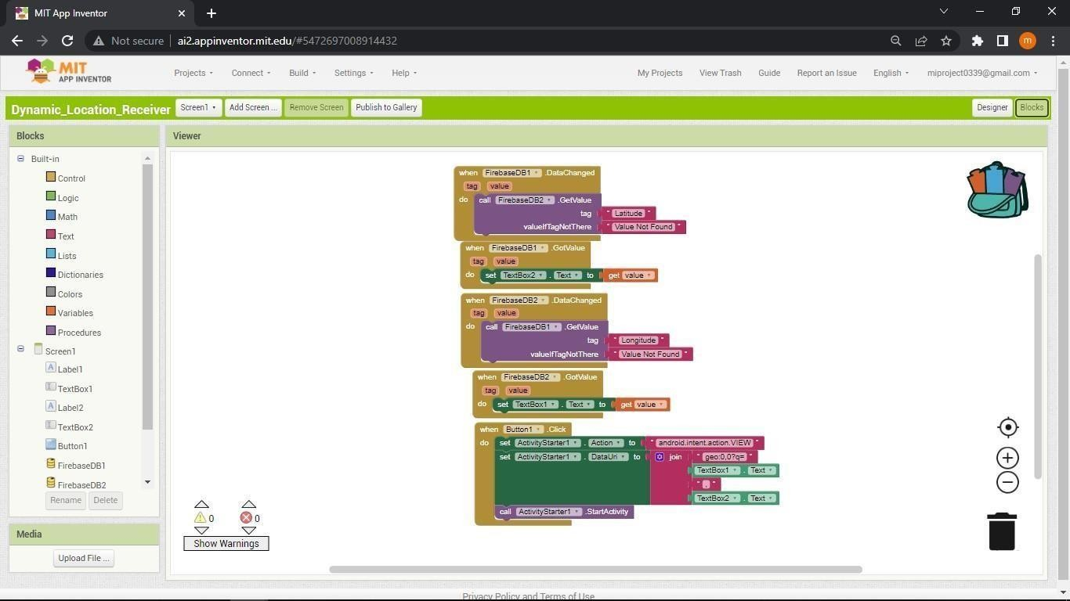
LOCATION UPDATER APP

Slide 13
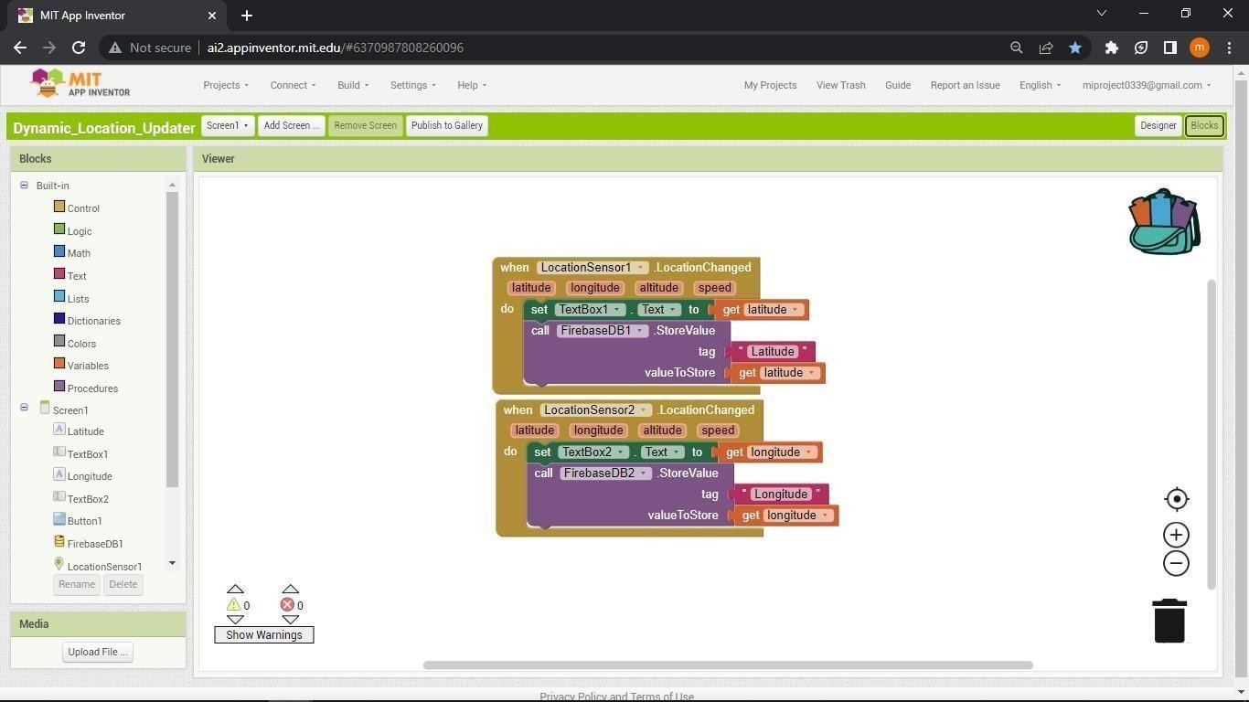
LOCATION RECEIVER APP

Slide 14
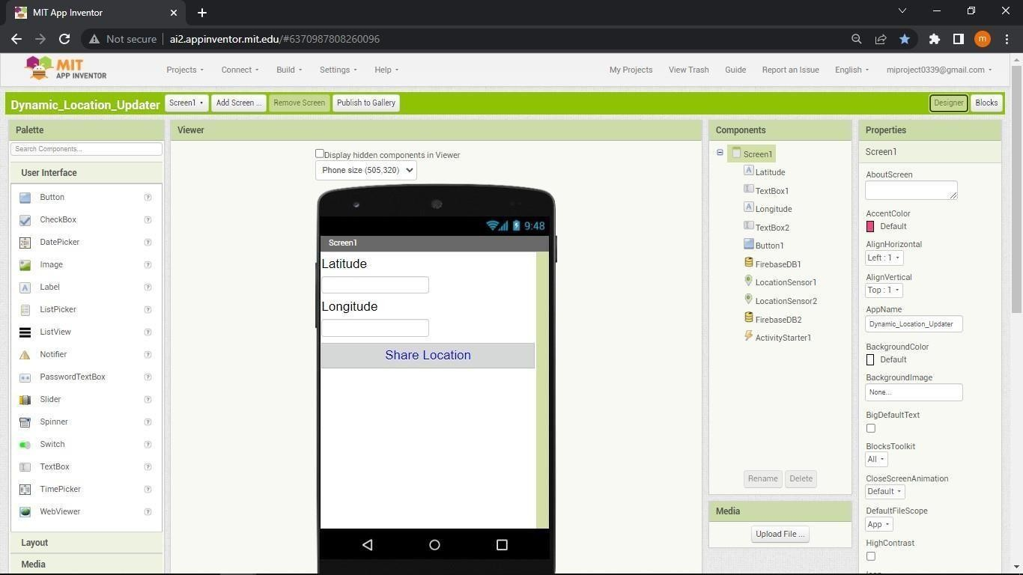
USER INTERFACE OF LOCATION UPDATER APP

Slide 15

USER INTERFACE OF LOCATION RECEIVER APP

Slide 16
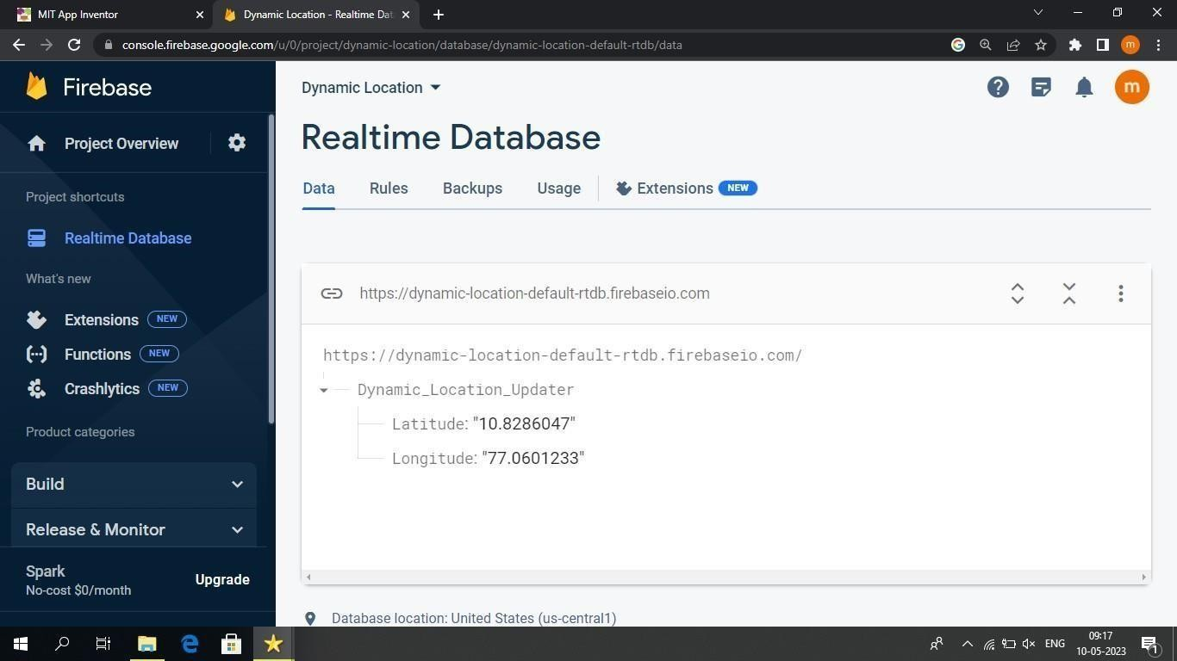
FIREBASE DATABASE

Slide 17
REFERENCES
"Real-Time Bus Tracking and Scheduling System": This project uses GPS and GSM technologies to track the location of buses
and provides real-time information to passengers about the bus schedules and expected arrival times. More information can be found at https://www.researchgate.net/publication/329232609_Real-Time_Bus_Tracking_and_ Scheduling_System
Eddie Chi-Wah Lau, ‘‘Simple Bus Tracking System’’, Journal of Advanced Computer Science and Technology Research, vol.3,
no.1, 2013
M.Arikaa,S.Konomi, and K.Ohnishi, “Navitime:Supporting pedestrian navigation in the real world,” IEEE Pervasive Comput., vol. 6, no. 3, pp. 21–29, Jul.–Sep. 2007.
Mane, Mr & Khairnar, Dr. Vaishali. (2014). Analysis of Bus Tracking System Using GPS on Smartphones. IOSR Journal of
Computer Engineering. 16. 10.9790/0661-162128082.

Slide 18
THANK YOU

